Slide 1
CHAPTER Profit
11 Maximization

Slide 2
The Nature and Behavior of Firms
A firm
  An association of individuals
    Who have organized themselves for the purpose of turning inputs into outputs
Firms
  All shapes and sizes
  Structure of their management
  Financial instruments

Slide 3
The Nature and Behavior of Firms
Simple model of a firm
  Technology given by the production function, f(k, l), with labor (l) and capital (k) as inputs
  Run by an entrepreneur
    Makes all the decisions
    Receives all the profits and losses from the firm’s operations
    Acts in his or her own self-interest: maximize the firm’s profits

Slide 4
The Nature and Behavior of Firms
Complicating factors
  Management team
  Shareholders
  Owners
  Outsourcing
Firms
  Are not individuals but can be much more complicated organizations
  Firm’s objectives: profit maximization

Slide 5
Profit Maximization
A profit-maximizing firm
  Chooses both its inputs and its outputs
    With the sole goal of achieving maximum economic profits
  Seeks to maximize the difference between total revenue and total economic costs

Slide 6
Profit Maximization
A profit-maximizing firm: makes decisions in a “marginal” way
  Examine the marginal profit obtainable from producing one more unit of hiring one additional laborer
    If the marginal profit >0, the extra output will be produced or the extra laborer will be hired
    If the marginal profit = 0, it would not be profitable to go further

Slide 7
Output Choice
Total revenue for a firm, R(q) = p(q)⋅q
Economic costs incurred, C(q)
  In the production of q
Economic profits, π
  The difference between total revenue and total costs
π(q) = R(q) – C(q) = p(q)⋅q –C(q)

Slide 8
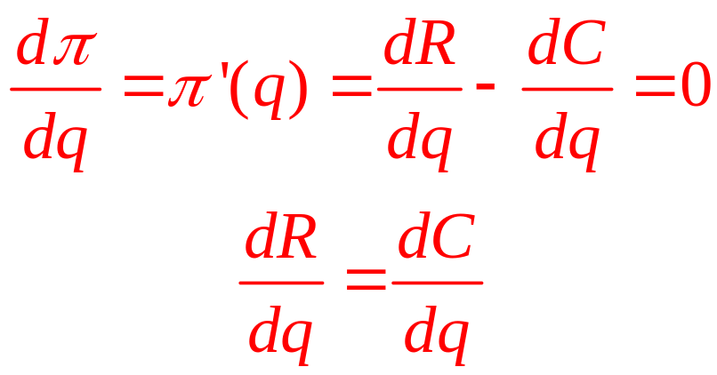
Output Choice
Maximize profits, choose q:
  Necessary condition to choosing q
  Set the derivative of the π function with respect to q equal to zero

Slide 9
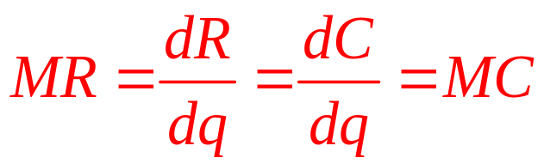
Output Choice
Marginal revenue, MR
  The change in total revenue R resulting from a change in output q
Marginal revenue = MR = dR/dq
Profit maximization
  Choose output q* at which MR(q*)=MC(q*)

Slide 10
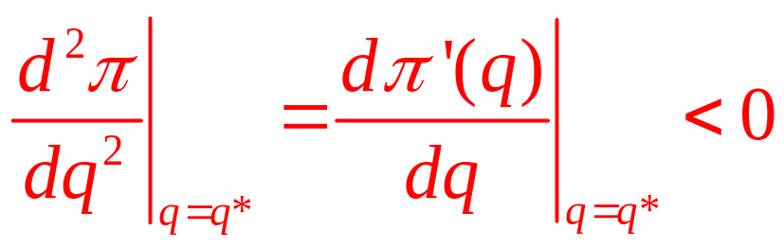
Second-Order Conditions
MR = MC
  Is only a necessary condition for profit maximization
For sufficiency, it is also required:
    ‘‘marginal’’ profit must decrease at the optimal level of output, q*
      For q<q*, π’(q) > 0
      For q>q*, π’(q) < 0

Slide 11
11.1 (a) Marginal Revenue Must Equal
Marginal Cost for Profit Maximization
Revenues,
Costs
C
R
q**
q*
Output per period
Profits, defined as revenues (R) minus costs (C), reach a maximum when the slope of the revenue function (marginal revenue) is equal to the slope of the cost function (marginal cost). This equality is only a necessary condition for a maximum, as may be seen by comparing points q* (a true maximum) and q** (a local minimum), points at which marginal revenue equals marginal cost.

Slide 12
11.1 (b) Marginal Revenue Must Equal
Marginal Cost for Profit Maximization
Profits
q*
Output per period
Losses
Profits, defined as revenues (R) minus costs (C), reach a maximum when the slope of the revenue function (marginal revenue) is equal to the slope of the cost function (marginal cost). This equality is only a necessary condition for a maximum, as may be seen by comparing points q* (a true maximum) and q** (a local minimum), points at which marginal revenue equals marginal cost.

Slide 13
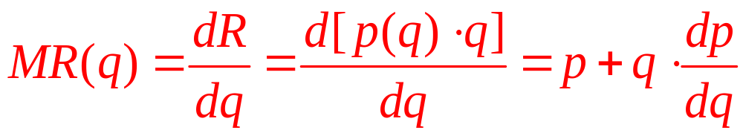
Marginal Revenue
Marginal revenue
  Equals price: if a firm can sell all it wishes without having any effect on market price
  If a firm faces a downward-sloping demand curve: more output can only be sold if the firm reduces the good’s price

Slide 14
Marginal Revenue
Marginal revenue is a function of output
  If price does not change as quantity increases
    dp/dq = 0, MR = p
    The firm is a price taker
  If price decreases as quantity increases
    dp/dq < 0, MR < p

Slide 15
11.1 Marginal Revenue from a Linear
Demand Function
Demand curve for a sub sandwich is
q = 100 – 10p
Solving for price: p = -q/10 + 10
Total revenue: R = pq = -q²/10 + 10q
Marginal revenue: MR = dR/dq = -q/5 + 10
  MR < p for all values of q
If the average and marginal costs are constant ($4)
  Profit maximizing quantity: MR = MC, so q*=30
  Price = $7, and profits = $90

Slide 16
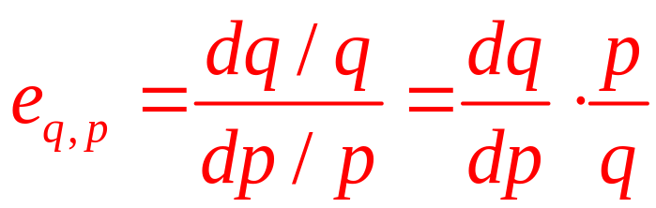
Marginal Revenue and Elasticity
Marginal revenue
  Directly related to the elasticity of the demand curve facing the firm
The price elasticity of demand
  Percentage change in quantity that results from a one percent change in price

Slide 17
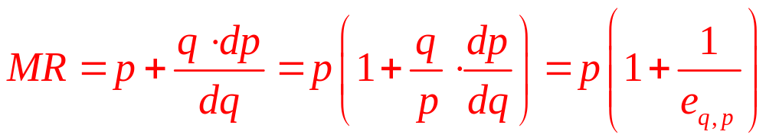
Marginal Revenue and Elasticity
This means that
  If demand curve slopes downward
    e_{q,p} < 0 and MR < p
  If demand is elastic: e_{q,p} < -1 and MR > 0
  If demand is infinitely elastic: e_{q,p} = -∞ and MR = p
  If demand is inelastic: e_{q, p} > 1 and MR < 0

Slide 18
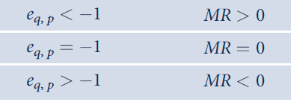
11.1 Relationship between Elasticity and
Marginal Revenue

Slide 19
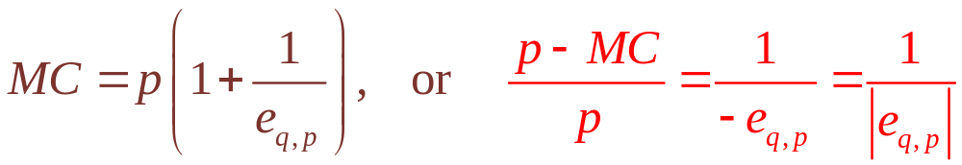
Price–Marginal Cost Markup
Maximize profits: MR = MC
    If demand is downward sloping and thus e_{q,p} < 0
  Formula for the percentage ‘‘markup’’ of price over marginal cost
  This demand facing the firm must be elastic, e_{q,p}<1
  The percentage markup over marginal cost will be higher the closer e_{q,p} is to 1

Slide 20
Average Revenue Curve
Assume
  That the firm must sell all its output at one price
  So, we can think of the demand curve facing the firm as its average revenue curve
    Shows the revenue per unit yielded by alternative output choices

Slide 21
Marginal Revenue Curve
Marginal revenue curve
  Shows the extra revenue provided by the last unit sold
  Below the demand curve
    In the case of a downward-sloping demand curve

Slide 22
11.2 Market Demand Curve and Associated
Marginal Revenue Curve
Price
p₁
D (average revenue)
q₁
Quantity per period
MR
Because the demand curve is negatively sloped, the marginal revenue curve will fall below the demand (‘‘average revenue’’) curve. For output levels beyond q₁, MR is negative. At q₁, total revenues (p₁ · q₁) are a maximum; beyond this point, additional increases in q cause total revenues to decrease because of the concomitant decreases in price.

Slide 23
Marginal Revenue Curve
When the demand curve shifts
  The marginal revenue curve associated with it shifts as well
A marginal revenue curve
  Cannot be calculated without referring to a specific demand curve

Slide 24
11.2 The Constant Elasticity Case
Demand function of the form: q = ap^{b}
  Has a constant price elasticity of demand = -b
  Solving this equation for p, we get
p = (1/a)^{1/b}q^{1/b} = kq^{1/b} where k = (1/a)^{1/b}
  Hence: R = pq = kq^{(1+b)/b}
  And MR = dR/dq = [(1+b)/b]kq^{1/b} = [(1+b)/b]p
This implies that MR is proportional to price

Slide 25
Short-Run Supply by a Price-Taking Firm
Price-taking firm
  Demand curve facing the firm is a horizontal line through (market price) P*=MR
  Profit-maximizing output level, q*
    P*= short run marginal costs; and marginal cost is increasing
  At q*, profits are
    Positive if price > average costs
    Negative (loss) if price < average costs
    Zero if price = average costs

Slide 26
11.3 Short-Run Supply Curve for a Price-Taking
Firm
Market price
SMC
P**
SAC
P* = MR
SAVC
P***
P_{s}
q***
q*
q**
Quantity per period
In the short run, a price-taking firm will produce the level of output for which SMC =P. At P*, for example, the firm will produce q*. The SMC curve also shows what will be produced at other prices. For prices below SAVC, however, the firm will choose to produce no output. The heavy lines in the figure represent the firm’s short-run supply curve.

Slide 27
Short-Run Supply by a Price-Taking Firm
Short-run supply curve
  The positively-sloped portion of the short-run marginal cost curve
  Above the point of minimum average variable cost
  It shows how much the firm will produce at every possible market price

Slide 28
Short-Run Supply by a Price-Taking Firm
Firms will only operate in the short run
  As long as total revenue covers variable cost
  p > SAVC
Firms will shut-down in the short-run
  If p < SAVC
  Produce no output

Slide 29
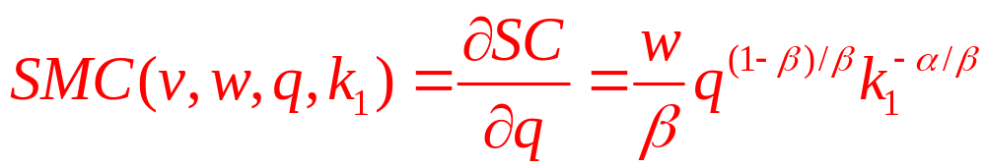
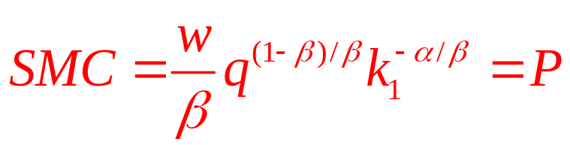
11.3 Short-Run Supply
Firm’s short-run total cost curve is
SC(v,w,q,k₁) = vk₁ + wq^{1/β}k₁^{-α/β}
    Where k₁ is the level of capital held constant in the short run
Short-run marginal cost is
The price-taking firm will maximize profit where p = SMC

Slide 30
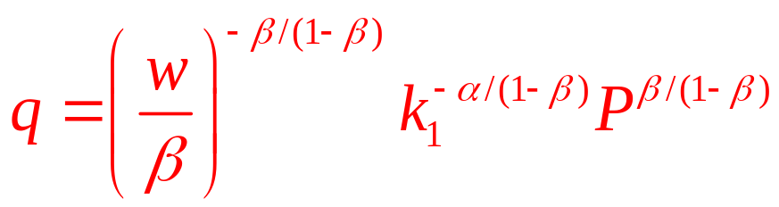
11.3 Short-Run Supply
Quantity supplied will be
To find the firm’s shut-down price, we need to solve for SAVC
SVC = wq^{1/β}k₁^{-α/β}
SAVC = SVC/q = wq^{(1-β)/β}k₁^{-α/β}
SAVC < SMC for all values of β < 1
  There is no price low enough that the firm will want to shut down

Slide 31
Profit Functions
A firm’s economic profit can be expressed as a function of inputs
π = Pq - C(q) = Pf(k,l) - vk - wl
  Only k, l, and q=f(k,l) are under firm’s control
  P, v, and w - fixed parameters
Profit function
  Shows its maximal profits as a function of the prices that the firm faces

Slide 32
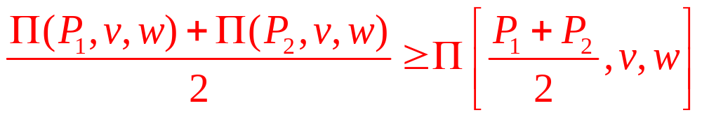
Properties of the Profit Function
Homogeneity
  The profit function is homogeneous of degree one in all prices
Nondecreasing in output price, P
Nonincreasing in input prices, v, and w
Convex in output prices

Slide 33
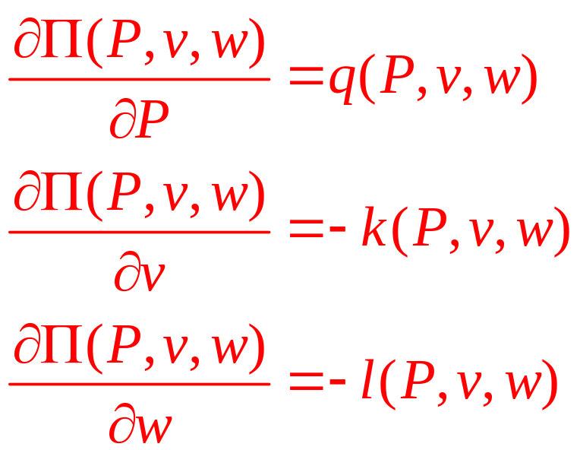
Envelope Results
Apply the envelope theorem
  To see how profits respond to changes in output and input prices

Slide 34
Producer Surplus in the Short Run
Profit function is nondecreasing in output prices
  If P₂ > P₁, Π(P₂,…) ≥ Π(P₁,…)
  The welfare gain to the firm of from the price change:
welfare gain = Π(P₂,…) – Π(P₁,…)

Slide 35
11.4 Changes in Short-Run Producer Surplus
Measure Firm Profits
SMC
Market price
P₂
A
P₁
B
P_{s}
C
q₁
q₂
q
If price increases from P₁ to P₂, then the increase in the firm’s profits is given by area P₂ABP₁. At a price of P₁, the firm earns short-run producer surplus given by area P_{s}CBP₁. This measures the increase in short-run profits for the firm when it produces q₁ rather than shutting down when price is P_{s} or below.

Slide 36
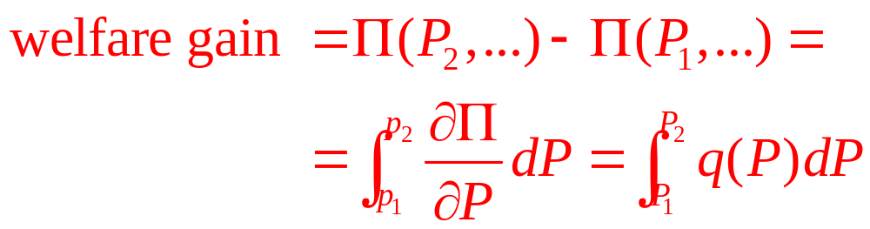
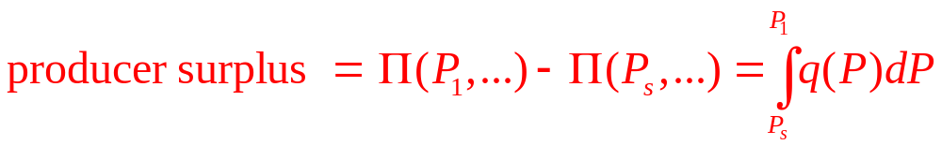
Producer Surplus in the Short Run
Welfare gain:
Producer surplus
  Extra profits available from facing a price of P₁

Slide 37
Producer Surplus in the Short Run
Producer surplus
  The extra return that producers make by making transactions at the market price
    Over and above what they would earn if nothing were produced
  The area below the market price and above the supply curve

Slide 38
Producer Surplus in the Short Run
At the shutdown price
  The firm produces no output, Π(P_{S},…)= -vk₁
  Losses = Fixed costs
  Producer surplus = current profits + short-run fixed costs
  producer surplus = Π(P₁,…) – Π(P_{S},…) =
  = Π(P₁,…) – (-vk₁) = Π(P₁,…) + vk₁ =
  = P₁q₁ - wl₁

Slide 39
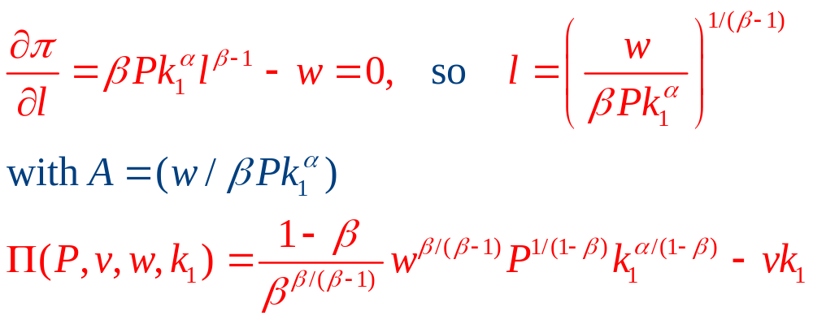
11.4 A Short-Run Profit Function
Cobb–Douglas production function, q=k^{α}l^{β}
    With k=k₁ in the short-run
    Profits are π=Pk₁^{α}l^{β} - vk₁ - wl
To find the profit function
  Use the first-order conditions for a maximum

Slide 40
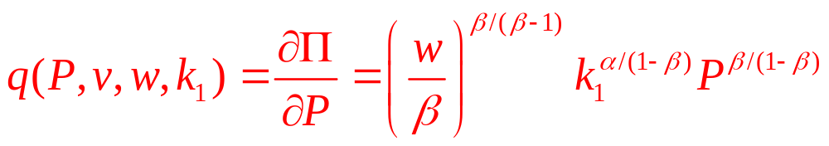
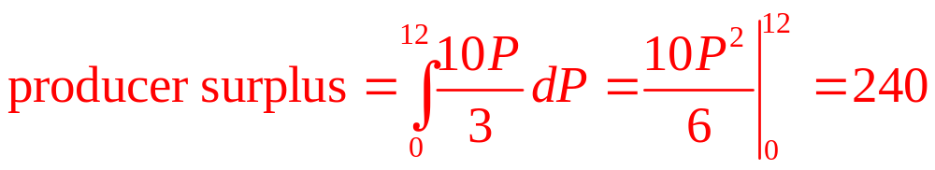
11.4 A Short-Run Profit Function
Hotelling’s lemma
  The firm’s short-run supply function
Producer surplus
  α = β =0.5, v = 3, w = 12, k₁ =80. With these parameters, q = 10P/3 and the shutdown price is zero. At P = 12:

Slide 41
Profit Maximization and Input Demand
A firm’s output
  Is determined by the amount of inputs it chooses to employ
Relationship between inputs and outputs
  Summarized by the production function
A firm’s economic profit
  Can be expressed as a function of inputs
π(k,l) = Pq –C(q) = Pf(k,l) – (vk + wl)

Slide 42
Profit Maximization and Input Demand
The first-order conditions for a maximum:
∂π/∂k = P[∂f/∂k] – v = 0
∂π/∂l = P[∂f/∂l] – w = 0
  Also imply cost minimization: RTS = w/v
A profit-maximizing firm
  Should hire any input up to the point at which
    Its marginal contribution to revenues is equal to the marginal cost of hiring the input

Slide 43
Profit Maximization and Input Demand
Marginal revenue product
  The extra revenue a firm receives
  When it uses one more unit of an input
  In the price-taking case, MRP_{l} = Pf_{l} and MRP_{k} = Pf_{k}

Slide 44
Profit Maximization and Input Demand
Second-order conditions:
π_{kk} = f_{kk} < 0
π_{ll} = f_{ll} < 0
π_{kk} π_{ll} - π_{kl}² = f_{kk}f_{ll} – f_{kl}² > 0
  Capital and labor must exhibit sufficiently diminishing marginal productivities so that marginal costs rise as output expands

Slide 45
Input Demand Functions
Input demand functions
Capital Demand = k(P,v,w)
Labor Demand = l(P,v,w)
  Are unconditional
  They implicitly allow the firm to adjust its output to changing prices

Slide 46
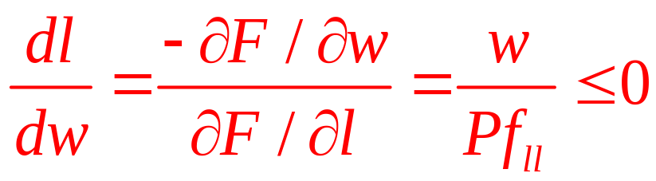
Single-Input Case
We expect ∂l/∂w < 0
  Diminishing marginal productivity of labor
The first order condition for profit maximization was: Pf_{l} - w = F(l,w,P)= 0
  Finding the derivative of an implicit function

Slide 47
Two-Input Case
For the case of two (or more inputs), the story is more complex
  If there is a decrease in w, there will not only be a change in l but also a change in k as a new cost-minimizing combination of inputs is chosen
    When k changes, the entire f_{l} function changes
But, even in this case, ∂l/∂w ≤ 0

Slide 48
Two-Input Case
When w falls
  Substitution effect
    If output is held constant, there will be a tendency for the firm to want to substitute l for k in the production process
  Output effect
    A change in w will shift the firm’s expansion path
    The firm’s cost curves will shift and a different output level will be chosen

Slide 49
11.5 The Substitution and Output Effects of a
Decrease in the Price of a Factor
(a) The isoquant map
(b) The output decision
k
per
period
Price
MC
MC’
A
k₁
C
P
k₂
B
q₂
q₁
l₁
l₂
l per period
q₁
q₂
Q per period
When the price of labor falls, two analytically different effects come into play. One of these, the substitution effect, would cause more labor to be purchased if output were held constant. This is shown as a movement from point A to point B in (a). At point B, the cost-minimizing condition (RTS = w/v) is satisfied for the new, lower w. This change in w/v will also shift the firm’s expansion path and its marginal cost curve. A normal situation might be for the MC curve to shift downward in response to a decrease in w as shown in (b). With this new curve (MC’) a higher level of output (q₂) will be chosen. Consequently, the hiring of labor will increase (to l₂), also from this output effect.

Slide 50
Cross-Price Effects
How capital usage responds to a wage change
  No definite statement can be made
  A fall in the wage will lead the firm to substitute away from capital
  The output effect will cause more capital to be demanded as the firm expands production

Slide 51
Substitution and Output Effects
When the price of an input falls
  Two effects cause the quantity demanded of that input to rise:
  1. The substitution effect causes any given output level to be produced using more of the input
  2. The fall in costs causes more of the good to be sold, thereby creating an additional output effect that increases demand for the input

Slide 52
Substitution and Output Effects
Two concepts of demand for any input
  Conditional demand for labor, l^{c}(v,w,q)
  Unconditional demand for labor, l(P,v,w)
  At the profit-maximizing level of output
l(P,v,w) = l^{c}(v,w,q) = l^{c}(v,w, q(P,v,w))

Slide 53
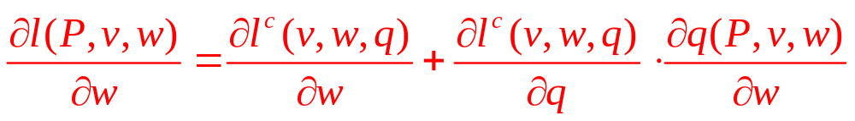
Substitution and Output Effects
Differentiation with respect to w yields
substitution effect
output effect
total effect

Slide 54
11.5 Decomposing Input Demand into
Substitution and Output Components
Cobb–Douglas function
  When one of the inputs is held fixed
q = f(k,l,g) = k^{0.25}l^{0.25}g^{0.5}
  Features:
    1. Permits capital–labor substitution
    2. Exhibits increasing marginal costs
  Where
    k is capital input, l is labor input
    g is the size of the factory, held constant at 16

Slide 55
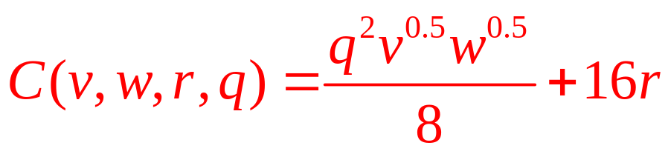
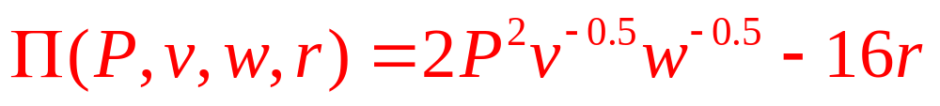
11.5 Decomposing Input Demand into
Substitution and Output Components
Cobb–Douglas function: q = 4 k^{0.25}l^{0.25}
  The factory can be rented at a cost of r per square meter per period
Total cost function
Profit function

Slide 56
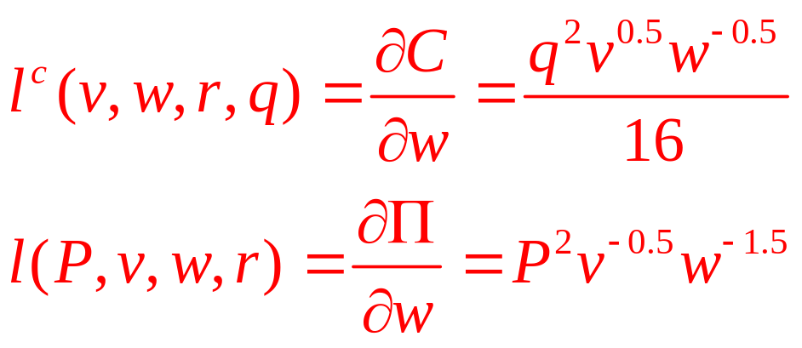
11.5 Decomposing Input Demand into
Substitution and Output Components
Envelope results
  A change in the wage has a larger effect on total labor demand
  Than it does on contingent labor demand
  Because the exponent of w is more negative in the total demand equation

Slide 57
Boundaries of the firm
Common features of alternative theories
  Property rights theory
  Transactions cost theory
Both theories
  If all markets looked like the supply–demand model encountered in principles courses, that would be the most efficient way to organize transactions
Markets look more like negotiations because of
  Uncertainty, complexity, and specialization

Slide 58
Property rights theory
S(x_{F},x_{G})
  Total surplus generated by the transaction between Fisher Body and GM
    Bargaining: each firm receives half of the surplus
  The sum of both firm’s profits
x_{F}
  Investments made by Fisher Body
x_{G}
  Investments made by GM

Slide 59
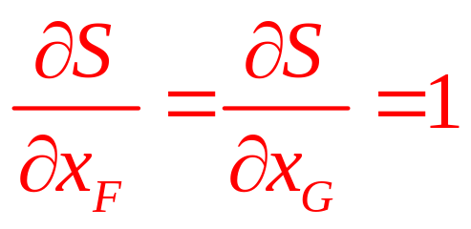
Property rights theory
Efficient investment levels
  Maximize total surplus minus investment costs
S(x_{F},x_{G}) - x_{F} - x_{G}
First-order conditions

Slide 60
Property rights theory
Objective function: 0.5 S(x_{F},x_{G}) - x_{F}
  First-order condition
    Investments by the firms (if they are two separete firms)
    0.5 (∂S/∂x_{F})=1 and 0.5 (∂S/∂x_{G})=1
GM acquires Fisher Body
  They become one firm
  Objective function: 0.5 S(x_{F},x_{G}) - x_{G}
  First-order condition: ∂S/∂x_{G}=1

Slide 61
Transactions cost theory
h_{F}
  Costly action undertaken by Fisher Body at the time of bargaining - increases its bargaining power at the expense of GM
  Haggling
h_{G}
  Costly action undertaken by GM at the time of bargaining - increases its bargaining power at the expense of Fisher Body
  Haggling

Slide 62
Transactions cost theory
Bargaining shares
  α(h_{F},h_{G}) - share accruing to Fisher Body
  1 - α(h_{F},h_{G}) - share accruing to GM
  Where 0 < α < 1, increasing in h_{F} and decreasing in h_{G}
Efficient levels of investment: x_{F}* and x_{G}*

Slide 63
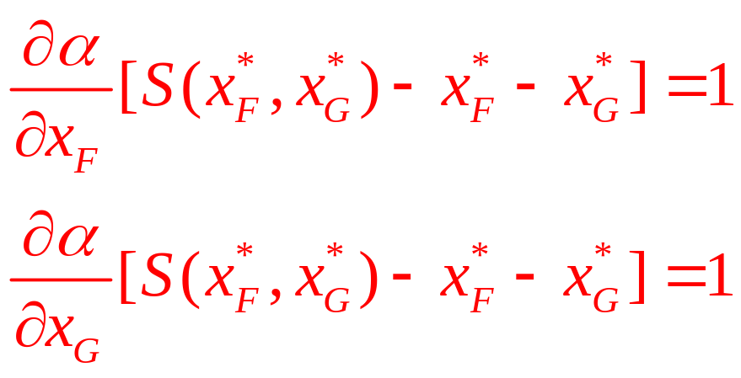
Transactions cost theory
Fisher Body’s objective function
  Determining its equilibrium level of haggling
α(h_{F},h_{G}) [S(x_{F}*,x_{G}*)- x_{F}* - x_{G}*]-h_{F}
First-order conditions

